Slide 1
Stable Diffusion, Segment Anything

Slide 2
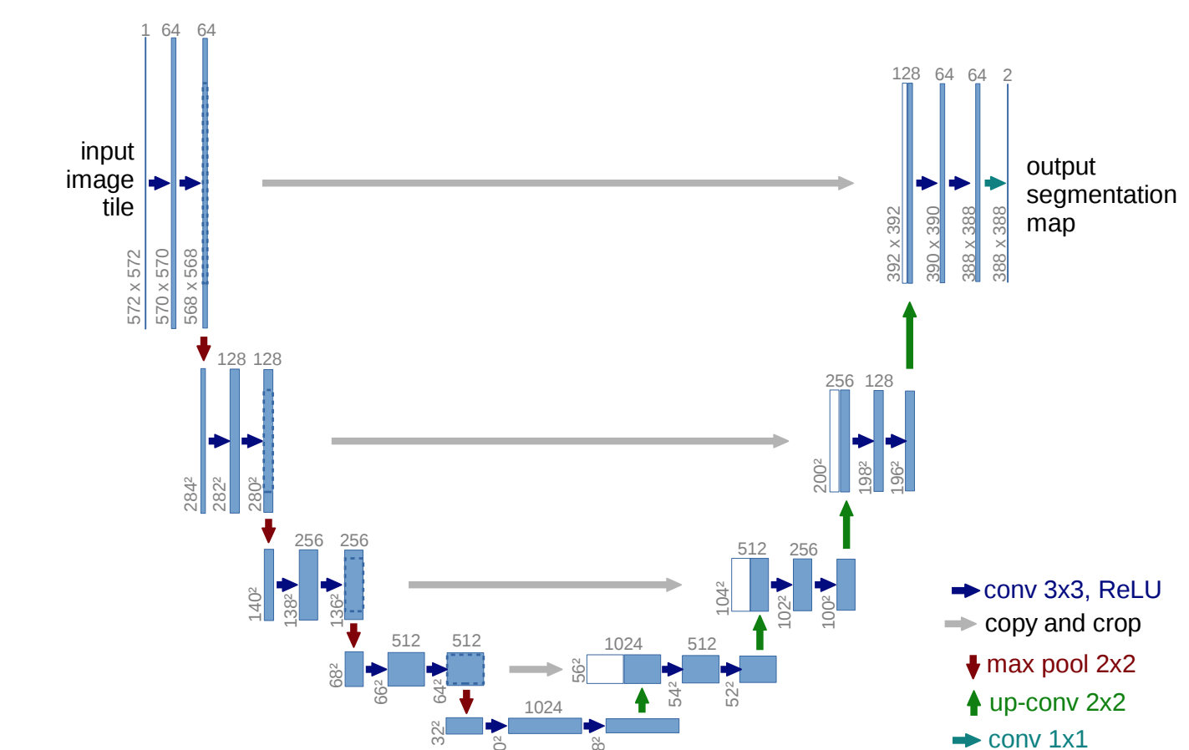
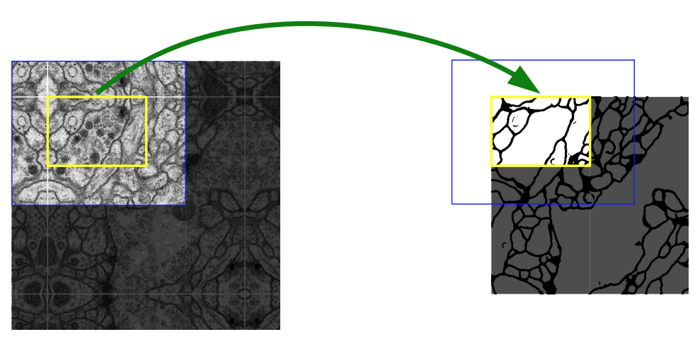
Сегментация U-Net
Ronneberger, Olaf, Philipp Fischer, and Thomas Brox. "U-net: Convolutional networks for biomedical image segmentation.”
International Conference on Medical image computing and computer-assisted intervention. Springer 2015.

Slide 3
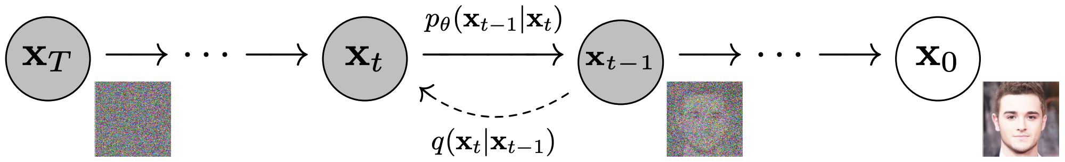
Stable diffusion как генератор
Ho, Jonathan, Ajay Jain, and Pieter Abbeel. "Denoising diffusion probabilistic models." Advances in neural information processing systems 33 (2020): 6840-6851.

Slide 4
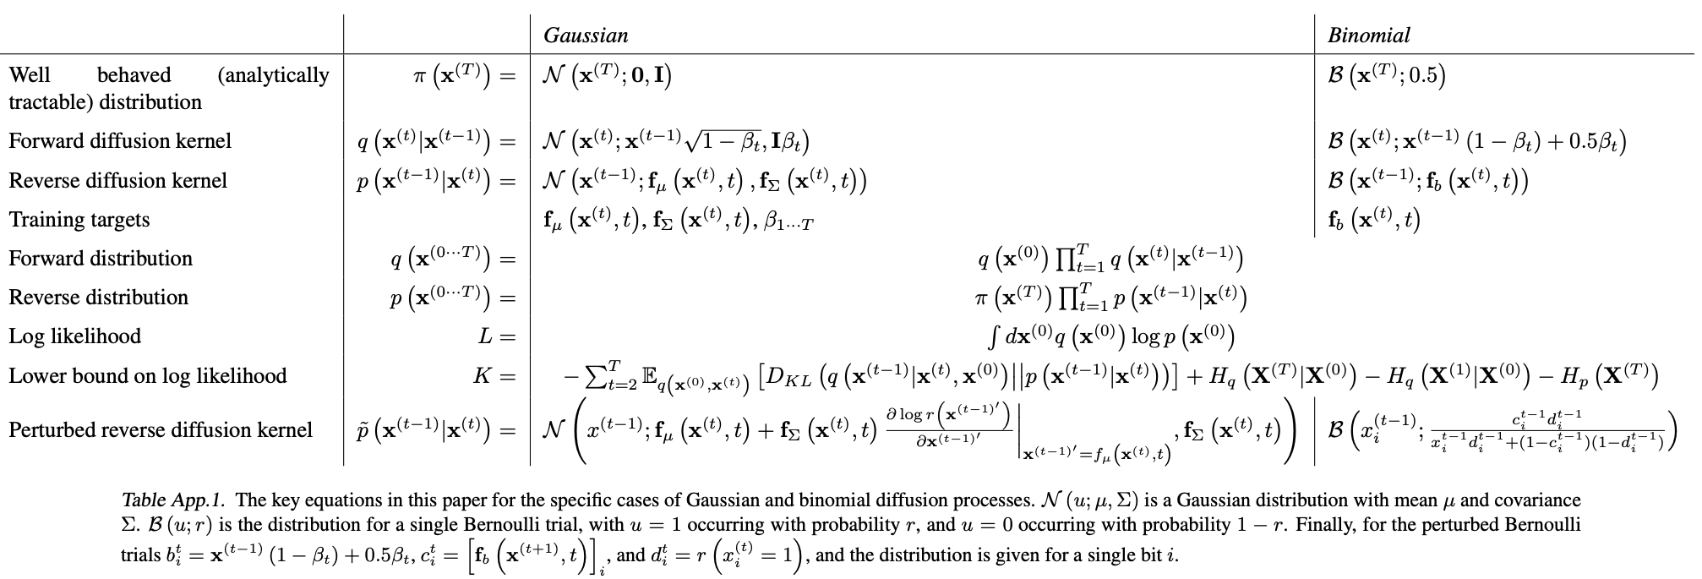
Математические понятия Stable Diffusion
Sohl-Dickstein, Jascha, et al. "Deep unsupervised learning using nonequilibrium thermodynamics." International conference on machine learning. pmlr, 2015.

Slide 5
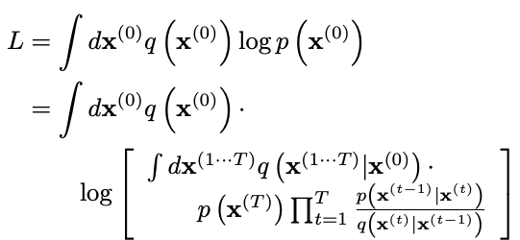
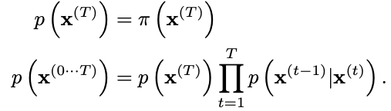

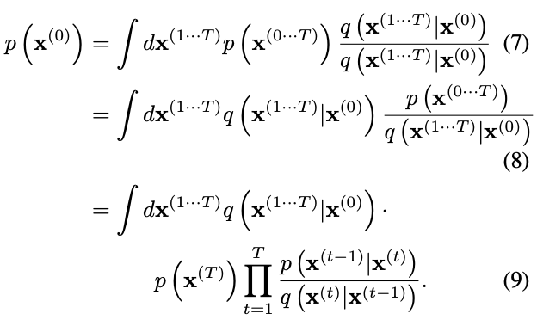
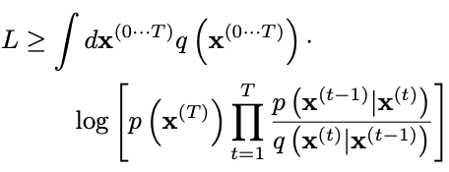
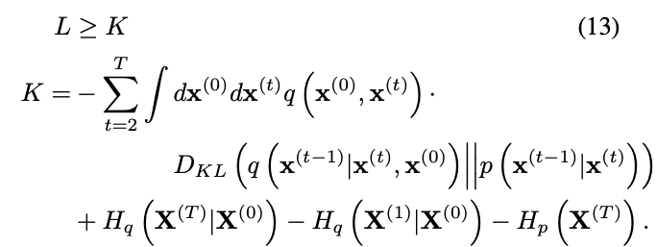

Функция потерь Stable Diffusion
Sohl-Dickstein, Jascha, et al. "Deep unsupervised learning using nonequilibrium thermodynamics." International conference on machine learning. pmlr, 2015.

Slide 6
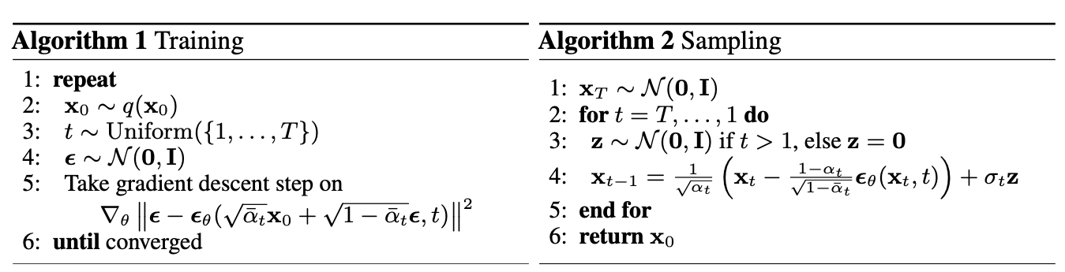
Алгоритмы обучения и генерации
Ho, Jonathan, Ajay Jain, and Pieter Abbeel. "Denoising diffusion probabilistic models." Advances in neural information processing systems 33 (2020): 6840-6851.

Slide 7
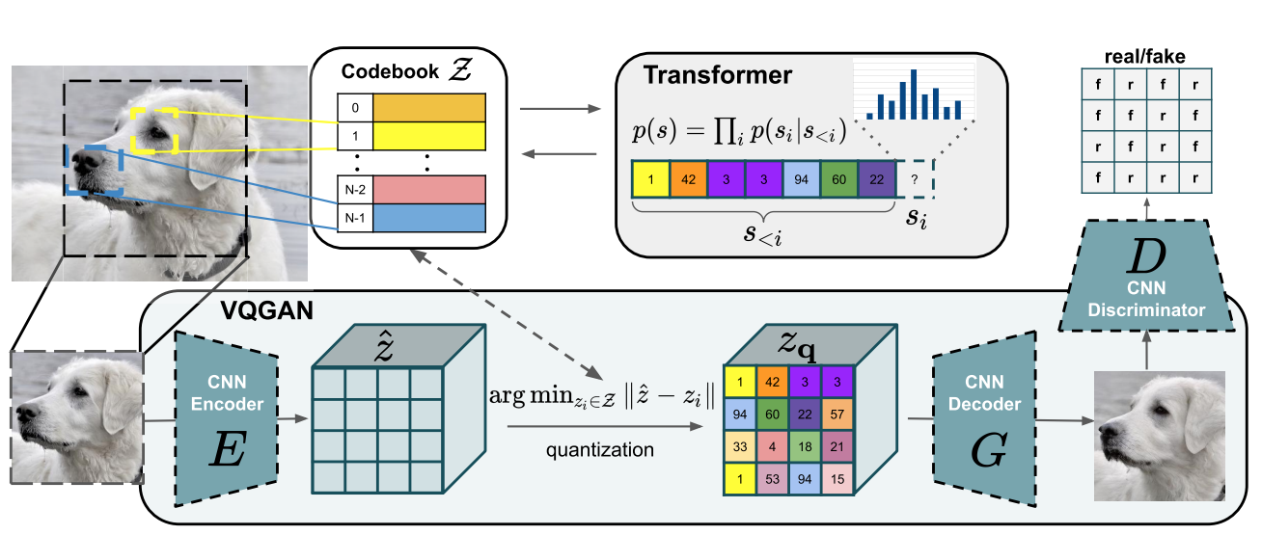
Генерация изображений высокого разрешения
Esser, Patrick, Robin Rombach, and Bjorn Ommer. "Taming transformers for high-resolution image synthesis." Proceedings of the IEEE/CVF conference on computer vision and pattern recognition. 2021.

Slide 8
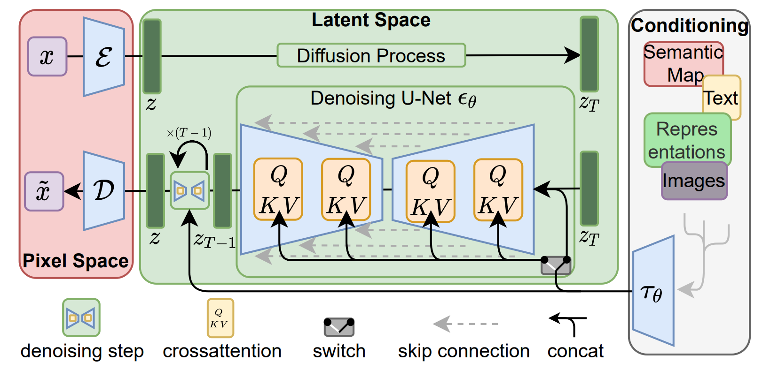
Условная генерация
Rombach, Robin, et al. "High-resolution image synthesis with latent diffusion models." Proceedings of the IEEE/CVF conference on computer vision and pattern recognition. 2022.

Slide 9
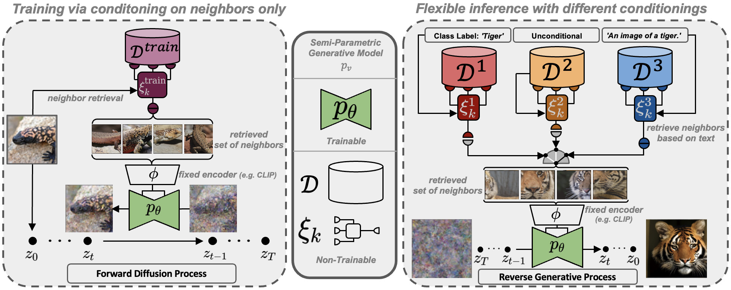
Детали обучения и генерации
Blattmann, Andreas, et al. "Semi-parametric neural image synthesis." arXiv preprint arXiv:2204.11824 (2022).

Slide 10
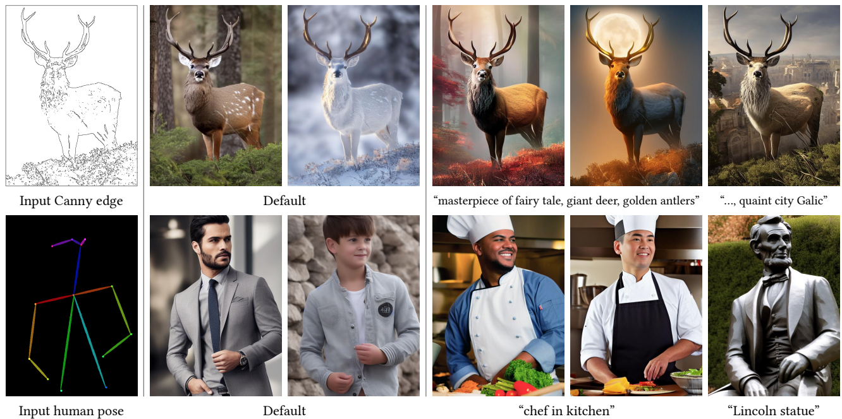
Генерация по дополнительным усолвиям
Zhang, Lvmin, Anyi Rao, and Maneesh Agrawala. "Adding conditional control to text-to-image diffusion models." Proceedings of the IEEE/CVF international conference on computer vision. 2023.

